Slide 1
Firewalls
At Dublin Business School

Slide 2
Today we will look at firewalls, in particular:
Packet Filtering Firewalls
Firewall Rule Sets
Firewall Services

Slide 3
What is a Firewall?
A firewall is a device (or software feature) designed to control the flow of traffic into and out-of a network.
In general, firewalls are installed to prevent attacks.

Slide 4
What is an attack?
‘Attack’ covers many things:
1. Someone probing a network for computers.
2. Someone attempting to crash services on a computer.
3. Someone attempting to crash a computer
4. Someone attempting to gain access to a computer, server and/or services to use resources or information.

Slide 5
Firewalls DO
Implement security policies at a single point
• Monitor security-related events (audit, log)
• Provide strong authentication
• Allow virtual private networks
• Have a specially hardened/secured operating system

Slide 6
Firewalls DON’T
Protect against attacks that bypass the firewall
• Dial-out from internal host to an ISP
• Protect against internal threats
Disgruntled employee
Insider cooperation with an external attacker
• Protect against the transfer of virus-infected programs or files

Slide 7
Types of Firewalls
Packet-Filtering Router
Application-Level Gateway
Circuit-Level Gateway
Hybrid Firewalls

Slide 8
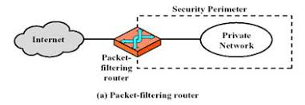
Packet Filtering Routers
Forward or discard IP packet according a set of rules
Filtering rules are based on fields in the IP and transport header

Slide 9
What information is used for filtering decision?
Source IP address (IP header)
Destination IP address (IP header)
Protocol Type
Source port (TCP or UDP header)
Destination port (TCP or UDP header)

Slide 10
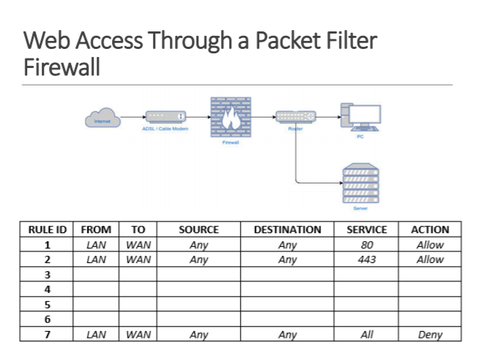

Slide 11
Packet Filtering Routers pros and cons
Advantages:
Simple
Low cost
Transparent to user
Disadvantages:
Hard to configure filtering rules
Hard to test filtering rules
Don’t hide network topology(due to transparency)
May not be able to provide enough control over traffic
Throughput of a router decreases as the number of filters increases

Slide 12
Stateless Firewalls
Stateless firewalls watch network traffic and restrict or block packets based on source and destination addresses or other static values.
They’re not ‘aware’ of traffic patterns or data flows.
A stateless firewall uses simple rule-sets that do not account for the possibility that a packet might be received by the firewall ‘pretending’ to be something you asked for.

Slide 13
Stateless Firewall
A stateless firewall filter, also known as an access control list (ACL), does not statefully inspect traffic. Instead, it evaluates packet contents statically and does not keep track of the state of network connections.

Slide 14
Statefull Firewalls
• Stateful firewalls can watch traffic streams from end to end. This is often referred to as Statefull Packet Inspection (SPI).
They are aware of communication paths and can implement various IP Security (IPsec) functions such as tunnels and encryption.
In technical terms, this means that stateful firewalls can tell what stage a TCP connection is in (open, open sent, synchronized, synchronization acknowledge or established).

Slide 15
Location of Firewalls
Edge Firewall
An edge firewall is usually software running on a server or workstation.
An edge firewall protects a single computer from attacks directed against it.
Examples of these firewalls are:
ZoneAlarm
IPTables
MS Windows Firewall

Slide 16
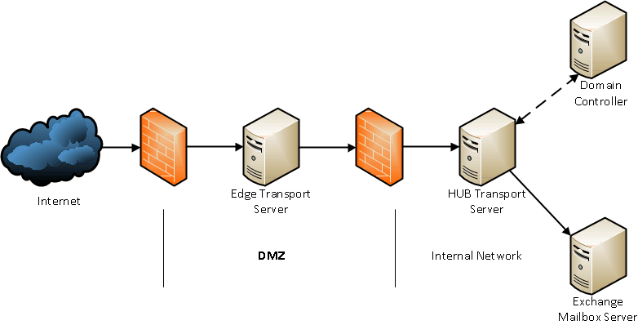
Edge Firewall

Slide 17
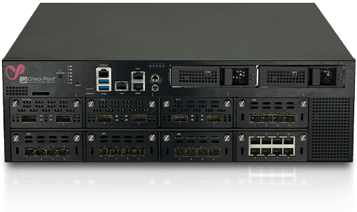
Firewall Appliance
An appliance firewall is a device whose sole function is to act as a firewall.
Examples of these firewalls are:
Fortinet
Palo Alto
Cisco

Slide 18
Router/Bridge based Firewall
A firewall running on a bridge or a router protects from a group of devices to an entire network.
Cisco has firewall feature sets in their IOS operating system.
Computer-based Network Firewall
A network firewall runs on a computer (such as a PC or Unix computer). ◦ These firewalls are some of the most flexible.
Many free products are available including IPFilter, PF and IPTables.

Slide 19
Protect a wide range of machines from general probes and many attacks.
Provides some protection for machines lacking in security.
Great First Line of Defense:
Having a firewall is a necessary evil.
It’s like living in a gated community.
The gate may stop 99% of unwanted visitors. The locks on your doors stop the remaining 1%.
Don’t let the firewall give you a false sense of security.
Harden your machines by turning off services you don’t need.

Slide 20
How does a firewall work?
Blocks packets based on:
Source IP Address or range of addresses.
Source IP Port
Destination IP Address or range of addresses.
Destination IP Port
Some allow higher layers up the OSI model.
Physical Interfaces (TO / FROM)
Other protocols

Slide 21
How does a firewall work?
Common ports
80 HTTP
443 HTTPS
20 & 21 FTP
23 Telnet
22 SSH
25 SMTP

Slide 22
To log or not to log…
If you set your rules to log too much, your logs will not be examined. If you log too little, you won’t see things you need. If you don’t log, you have no information on how your firewall is operating

Slide 23
Where does a firewall fit in the security model?
The firewall is the first layer of defense in any security model.
It should not be the only layer, think of DiD.
A firewall can stop many attacks from reaching target machines. If an attack can’t reach its target, the attack is defeated.

Slide 24
Designing a Rule Set
Ruleset design
A rule set is a collection of similar rules which allows ease of management by grouping similar rules/roles together, such as OUTBOUND, INBOUND, WEBACCESS, DMZ … etc
Two main approaches to designing a ruleset are:
1. Block everything then open holes.
2. Block nothing then close holes.

Slide 25
Ruleset design – Block Everything
Blocking everything provides the strongest security but the most inconvenience. Things break and people complain.
The block everything method covers all bases but creates more work in figuring out how to make some applications work then opening holes.

Slide 26
Ruleset design – Block Nothing
Blocking nothing provides minimal security by only closing holes you can identify. Blocking nothing provides the least inconvenience to our users.
Blocking nothing means you must spend time figuring out what you want to protect yourself from then closing each hole.

Slide 27
Filtering bad traffic
Sending bad traffic or malformed packets is a form of attack easily blocked at a firewall.
The firewall inspects every packet and rejects those that are not properly formed or are intentionally malformed, protecting devices that may be susceptible.

Slide 28
Black hole or Return-RST
Should you tell a sending machine that their traffic was blocked or let them wait until they timeout?
For some traffic, it’s better to let the sending machine wait.
This slows down the rate of attack.
For other traffic (such as SMTP) it may be nice to tell the sender that the SMTP port is closed.

Slide 29
Firewall Services
Modern Firewall firewalls may run several services. These include: Virtualisation: With today’s firewall appliances, it often possible to create virtual firewalls on the appliance. For example, the firewall appliance could run 3,4 or 5 virtual firewalls. This is generally to facilitate multiple administrators in a tenant environment.
Anti-Virus: Most modern firewalls will also use anti-virus. The anti-virus service scans network traffic real-time and blocks malicious traffic.
Web-Filtering: It is common for firewalls to implement a web- filtering module. This allows firewalls to block website access based on category (such as adult, gambling, social media) as well as blocking well-known malicious websites.

Slide 30
Firewall Services
VPN: VPN (Virtual Private Network) is a common services that many firewalls offer. This allows remotes users access the LAN or the ability to connect a remote site to the main network.
Subscription: Many firewall manufacturers offer subscription services; these include anti-virus subscriptions and threat intelligence subscriptions.
SSL/SSH Inspection: This service allows the firewall to examine and inspect SSL and SSH packets. This often needs to be implemented via HR and well documented, such as AUP.

Slide 31
Firewall Services
Sandbox: This is a technique in which you create an isolated test environment, a “sandbox,” in which to execute or “detonate” a suspicious file or URL that is attached to an email or otherwise reaches your network and then observe what happens.
Network Services: Firewalls will also provide network services such as routing and DHCP.
IDS/IPS: It is common for firewalls to implement monitoring, this includes Intrusion Detection and Prevention technologies.

Slide 32
Today … Today we looked at firewalls, in particular:
Packet Filtering Firewalls
Firewall Rule Sets
Firewall Services

